Slide 1
The four modes of communication – an introduction
CEFR Companion Volume implementation toolbox
Boîte à outils pour la mise en œuvre volume complémentaire du CECR
© 2023. This work is licensed under an Attribution-NonCommercial-ShareAlike International Creative Commons CC-BY-NC-SA 4.0 License. Attribution: Original activity from Fischer Johann (et al.) (2023), CEFR Companion Volume implementation toolbox, Council of Europe (European Centre for Modern Languages), Graz, available at www.ecml.at/companionvolumetoolbox.

Slide 2
The four modes of communication
Council of Europe (2020: 33):
“With its communicative language activities and strategies, the CEFR replaces the traditional model of the four skills (listening, speaking, reading, writing), which has increasingly proved inadequate in capturing the complex reality of communication. […] Activities are presented under four modes of communication: reception, production, interaction and mediation.”
Descriptor scales and descriptors are now grouped according to the four modes of communication, focusing on the function of the activity.

Slide 3
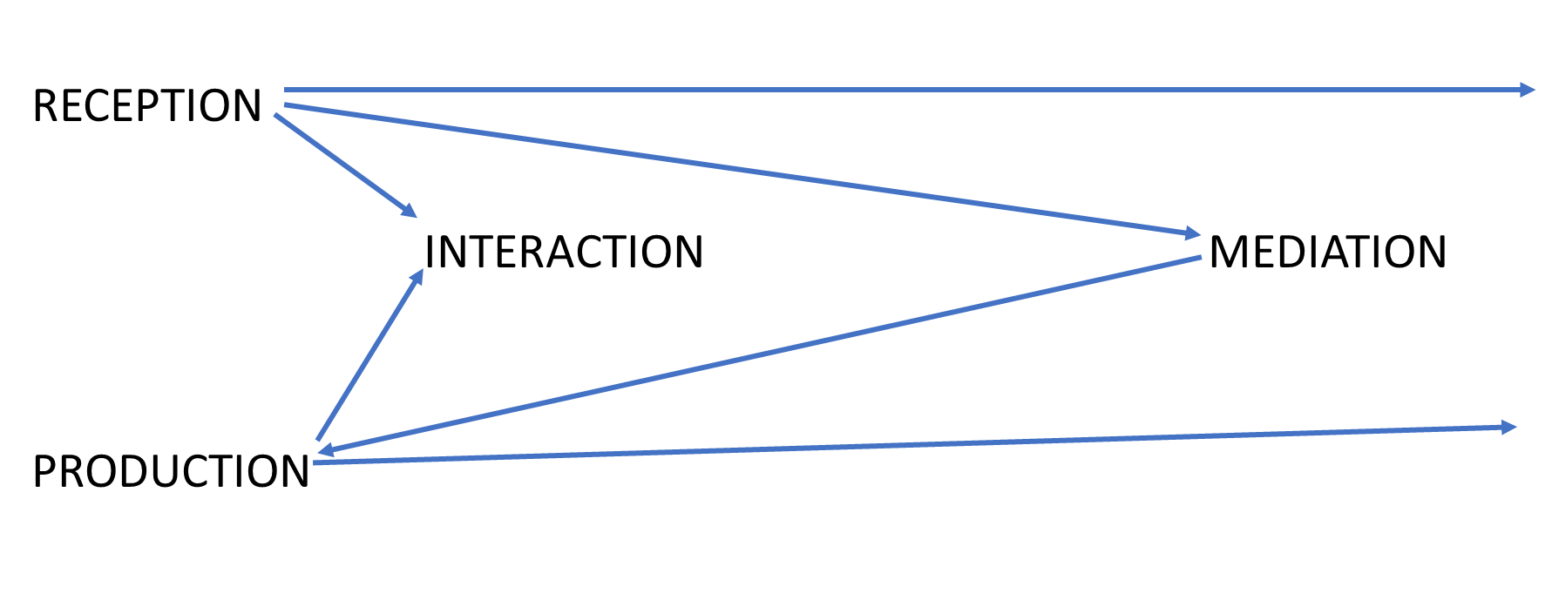
The four modes of communication
Council of Europe (2020): Common European Framework for Languages: Learning, Teaching, Assessment. Companion volume, 34.
https://rm.coe.int/common-european-framework-of-reference-for-languages-learning-teaching/16809ea0d4

Slide 4
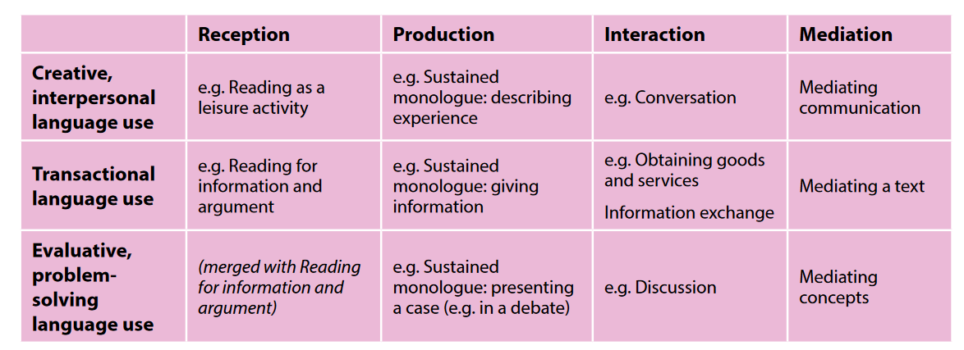
Focus on purpose / macro-function
Macro-functional basis of CEFR categories for communicative language activities (Council of Europe 2020: 34).

Slide 5
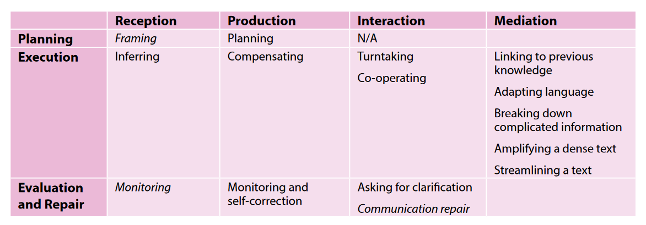
Focus on purpose / macro-function
Communicative language strategies in the CEFR (Council of Europe 2020: 35).

Slide 6
The four modes of communication
Reception:

Slide 7
The four modes of communication
Production:

Slide 8
The four modes of communication
Interaction:

Slide 9
The four modes of communication
Mediation:

Slide 10
The four modes of communication and the role of the learner
See: Fasoglio / Leunissen
(forthcoming).

Slide 11
The four modes of communication and the four skills
What is the relationship between the four modes of communication and the four language skills?
The four language skills (listening, reading, speaking and writing) are still necessary skills for teaching, learning and assessment, while the four modes of communication focus on the purpose or the macro-functions of communication. (see Council of Europe 2020: 33)

Slide 12
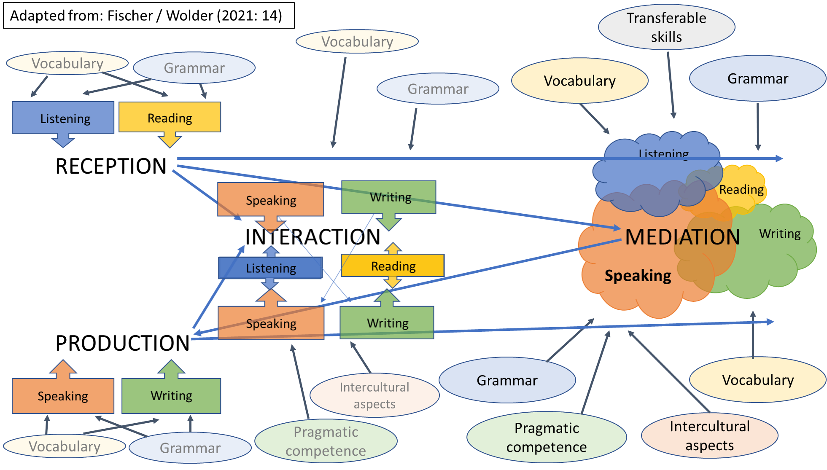
The four modes of communication and the four skills

